Slide 1
Eye Movement Miscue Analysis:
Building a low-cost software solution
26th Annual Arizona Space Grant Consortium Symposium
ASU, Phoenix, AZ
Shawtaroh (Shawn) Granzier-Nakajima, UA/NASA Space Grant
David Yaden, UA Prof. Language, Reading & Culture
April 22, 2017
Notes:
8-9 months

Slide 2
Eye Movement Miscue Analysis (EMMA)
Towards a theory of reading
Eye-Tracking during Read-Alouds
Perception
Oral Retellings
Interview
Probe about miscues
Commercial software doesn’t provide syncing of audio and visual files
Notes:
simultaneous eye-tracking and audio-recording of oral-readings to understand readers’ patterns of visual attention to text and their their subsequent comprehension. Unfortunately, commercial eye-tracking software doesn’t provide syncing of audio and visual files, so equipment and software need to be tailored. “There is no firm definition for a fixation. It is less a physiological quantity than a method for categorizing sections of a data stream” (ASL, D7 Manual, p. 50) We use 50ms, 1.0° Visual Angle “We can often say that specific regions were ‘looked at,’ perhaps even fixated; however, we cannot be fully confident that these specific regions were fully perceived. ” (Duchowski, 2007, p. 209)

Slide 3
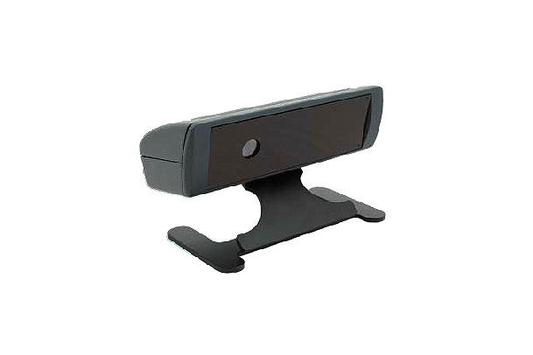
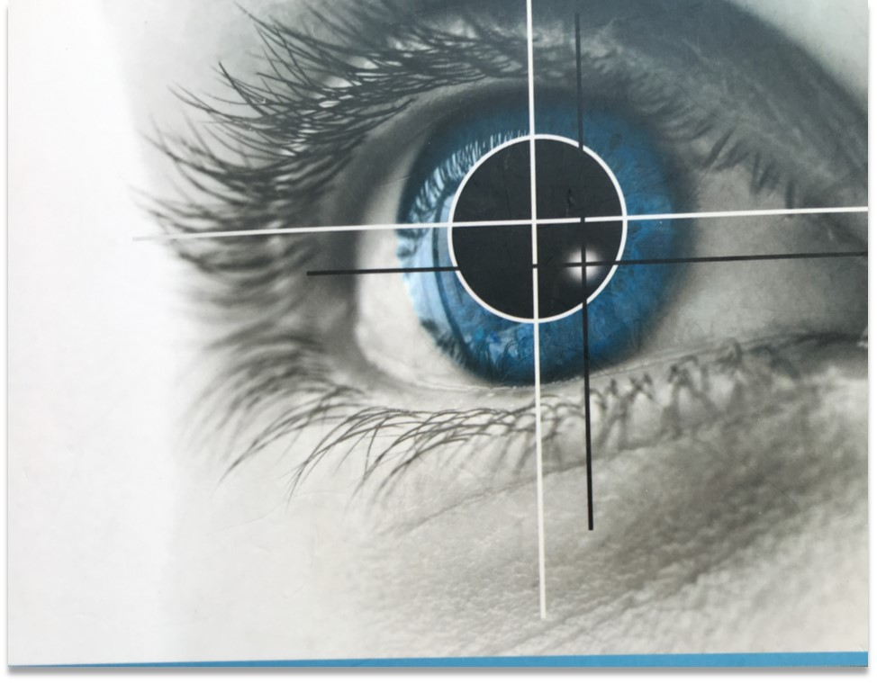
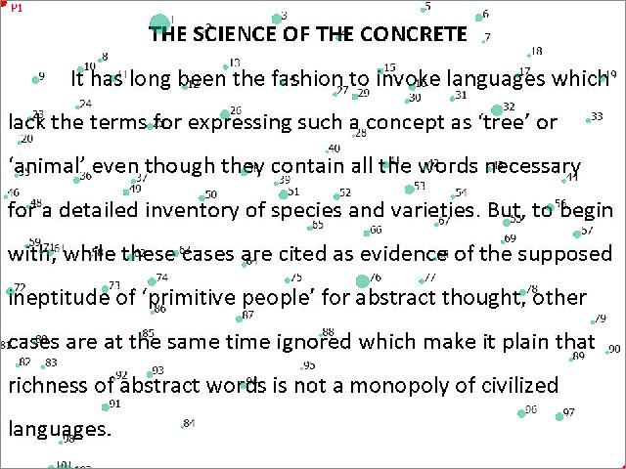
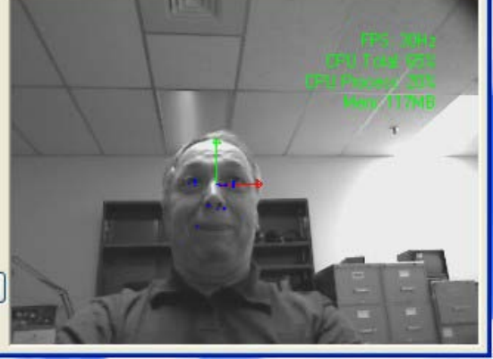
Domain Analysis
ASL D6 Remote Tracker
Notes:
We use 50ms, 1.0° Visual Angle

Slide 4
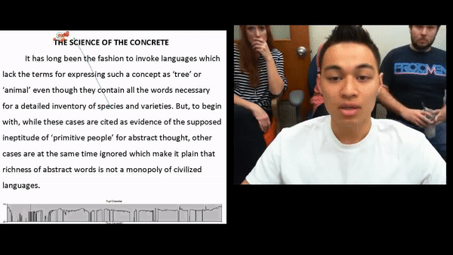

Slide 5
Modifications
Hardware
Secondary keyboard
Page advancement tracked with XDAT markers
Webcam & Speakers
Record reader’s facial cues
Captures reader’s oration
Creates syncing markers
Software
Batch and AutoHotkey Scripts
Automates experimental setup, recording, analysis (Open Source libraries: ffmpeg, vlc, sox)

Slide 6
Conclusions
Modular
Few keystrokes
Syncs audio and eye-movement files
Enables multi-page readings
Future
Coloring Books
July EMMA Conference
Pharmacist Prescriptions

Slide 7
Acknowledgements
David Yaden
Ken and Yetta Goodman
Kelly Allen
David Betts
NASA Space Grant
University of Arizona/ ASU

Slide 8
Thank you

Slide 9
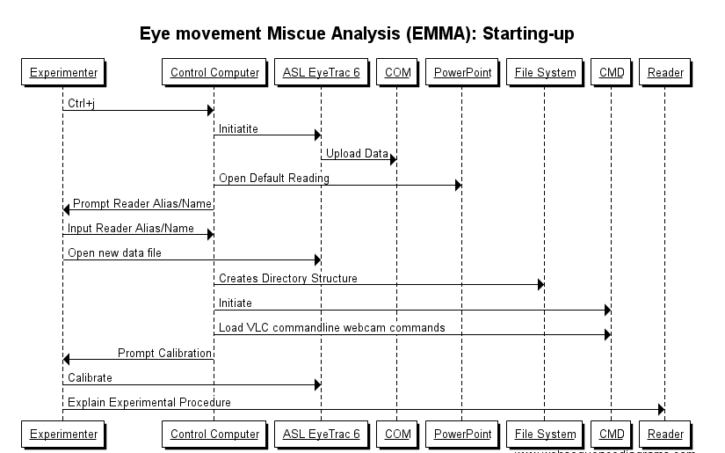

Slide 10
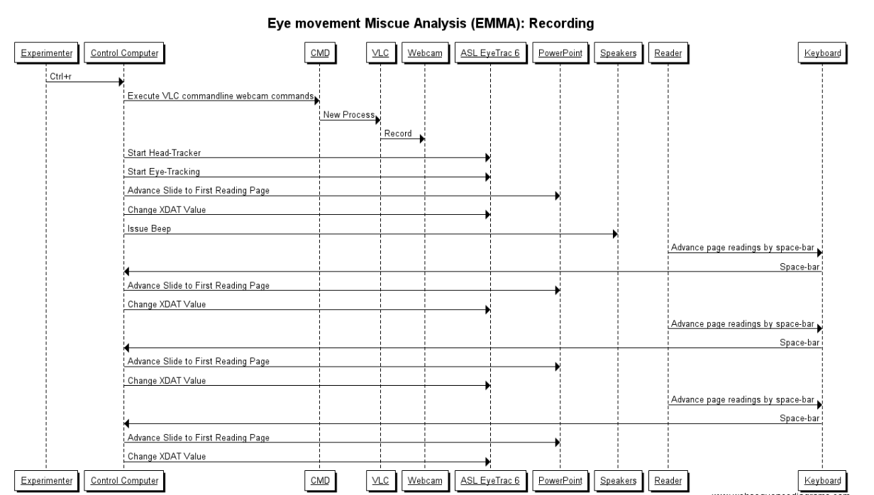

Slide 11
